Slide 1

Data Engineering_1
Global Sucide

Slide 2

GLOBAL SUICIDE
Kaggle Dataset
Time Frame : 1985 to 2016
Total Number Of Records : 27000 +
Variable used for analysis :
Country , Year , Sex , Age , Suicides , Population , Suicide per 100, Country year , HDI , GDP per Capita ,Generation
Dropped variable if any :
All the variables were taken into consideration although we restricted our analysis for the year 2015

Slide 3
ANALYTICAL QUESTION
Relation of economic indicators with Suicide rates ?
Distribution between Demographics & Suicide
Trend of reported Suicide case

Slide 4



DATA WAREHOUSING AND ETL

Slide 5
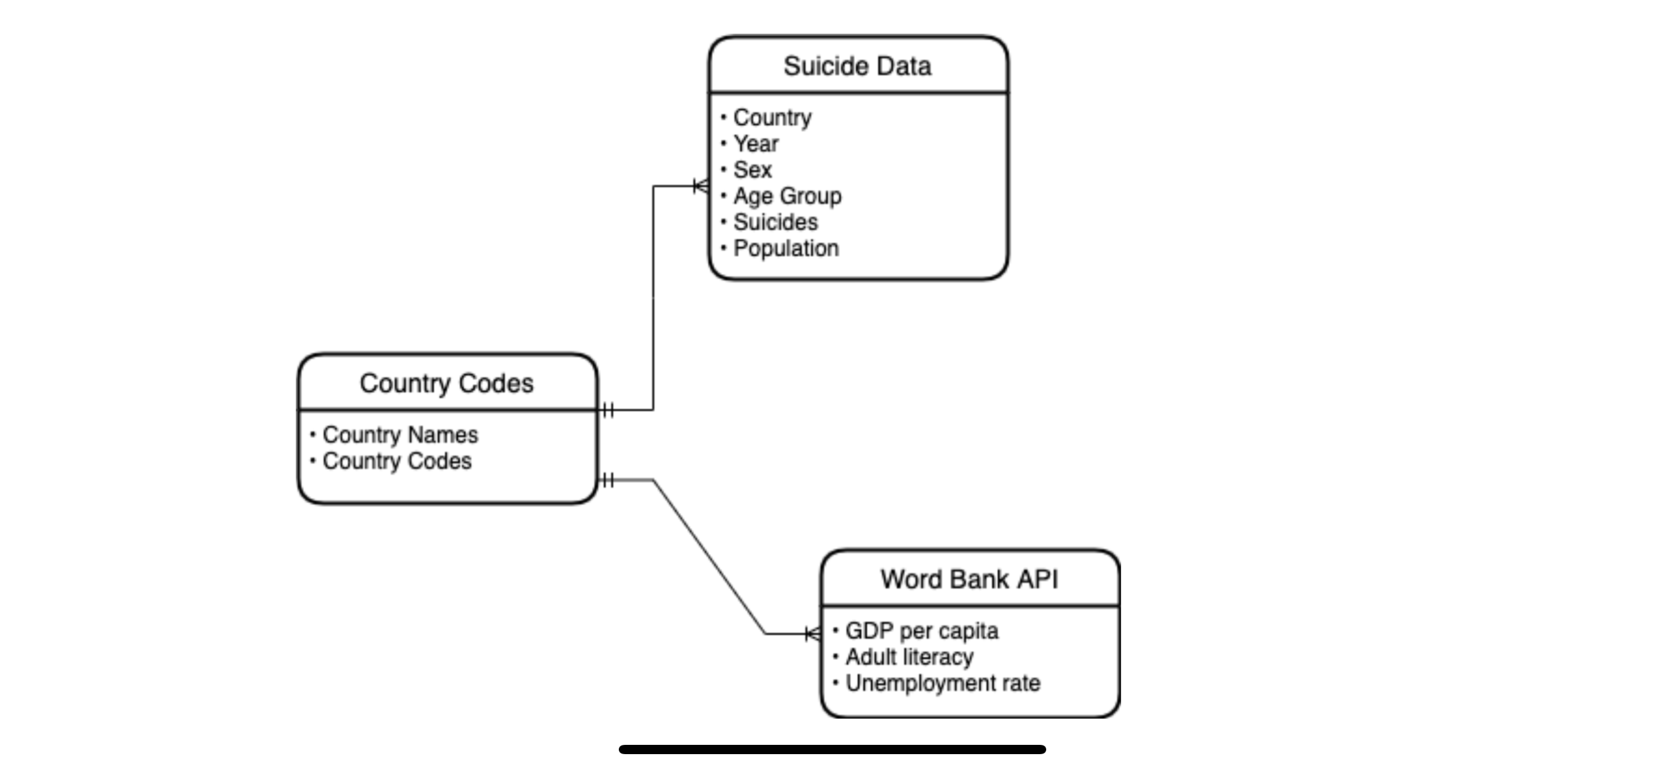
DIMENSION TABLE

Slide 6
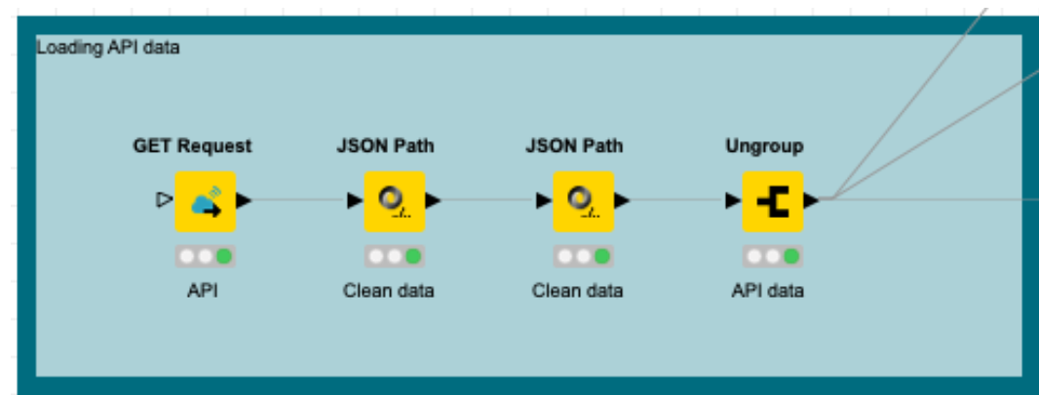
Loading data through API
After the calling the API, we process the data through two nodes to clean the data and get rid of unnecessary header and page numbers
The ungroup node was later used to convert the data into table format . However, the table needed further cleaning before we could run our analysis on it.

Slide 7
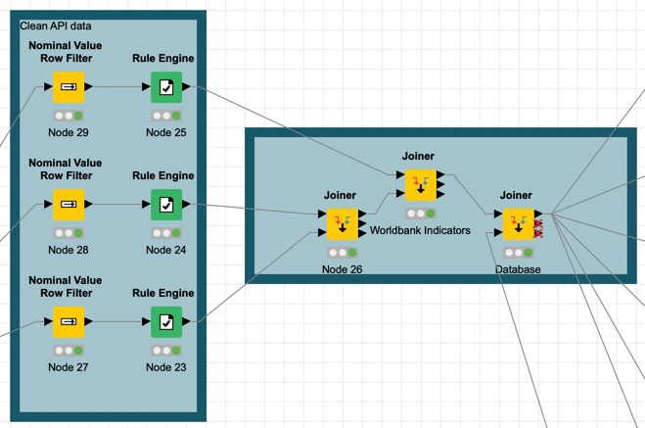
Cleaning the API Data
The three main variable that we called using API were :
GDP per capita
Unemployment
Literacy rate
The use nominal value filter along with rule engine was done precisely to extract value of each observation and convert it into a variable.

Slide 8

Loading & Merging Database

Slide 9
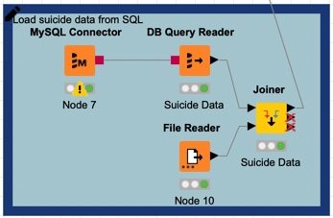
Loaded Data from MySQL
We loaded the data from SQl in Knime workflow using MySQL connector and DB Query Reader.
In the next step we merge this database with another table to merge country codes to our data.

Slide 10
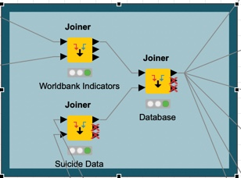
DataWareHouse
The last step was to make a data warehouse based on our suicide and the world bank dataset.
Based on these datawarehouse we preformed our analysis to understand the correlation between our different variables and suicides rate

Slide 11

VISUALIZATION ~ Year 2015
Unemployment & Suicide Rate (100k)
Gender & Age Distribution Sun-Burst Chart
Yearly Trend for Suicide from 2010 to 2015
GDP per capita & Suicide Rate (100k)

Slide 12
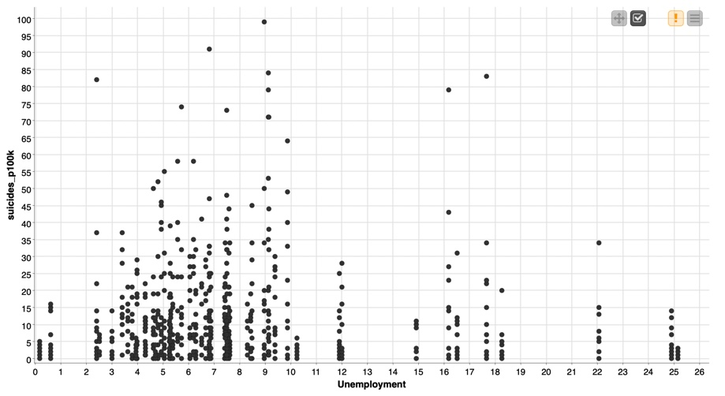
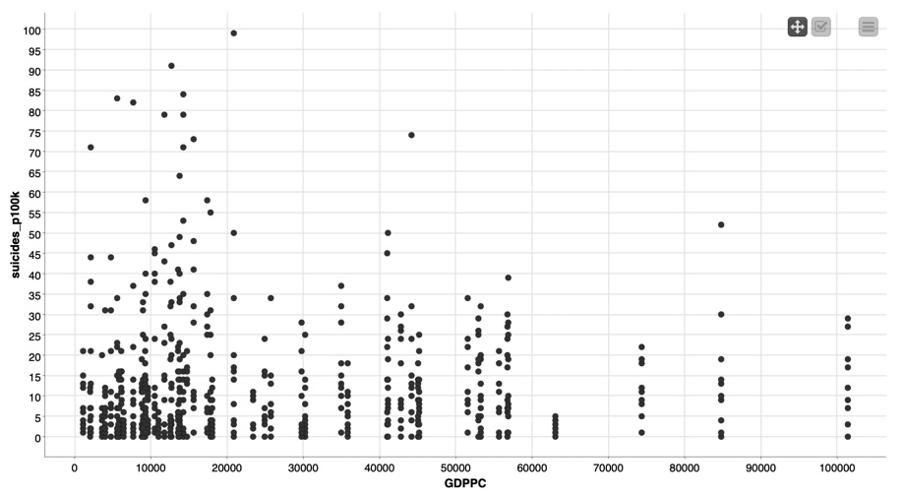
Scatter-Plot

Slide 13
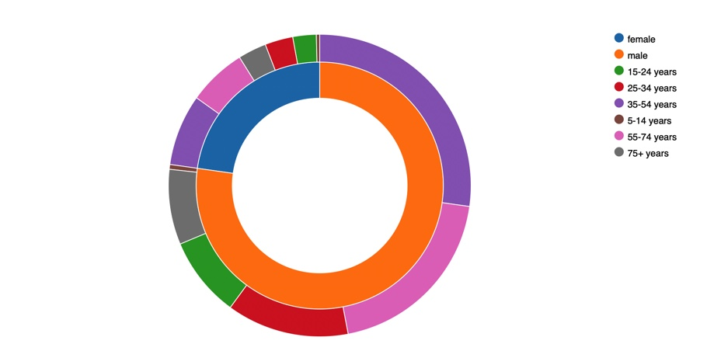
Sun-Burst Chart
Male ratio accounted for 77.2%.
From this sub-set majority of the male’s belonged to the age group of 35 -54 Years
Female ratio accounted for 22.8 %
With majority age group lying in the bracket of 35-54 Years.

Slide 14
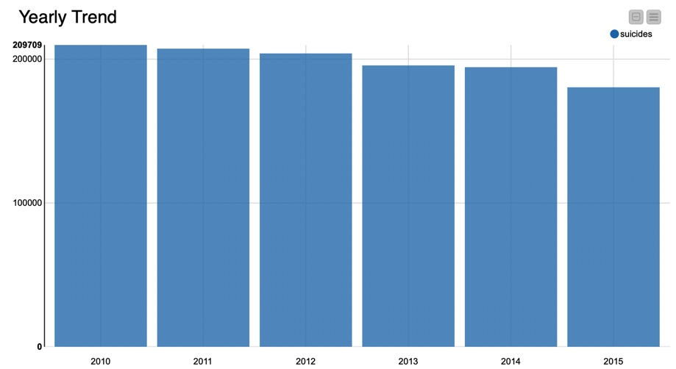
Bar Representation

Slide 15

Conclusion
According to our analysis we concluded that male suicide rate were higher as compare to female. Morevover, based on our result we witness that major occurrence of suicide belonged to generation X (35-54 years).
In our comparison with economic indicators and suicide rate the graph illustrated that countries with higher employment rate had more reported suicide cases.
Whereas in our analysis with GDP per capita we found that countries with lower GDPPC had higher number of suicides. Depicting negative correlation between # of sucide and their standard of living.

Slide 16


QUESTION ?

